Slide 1
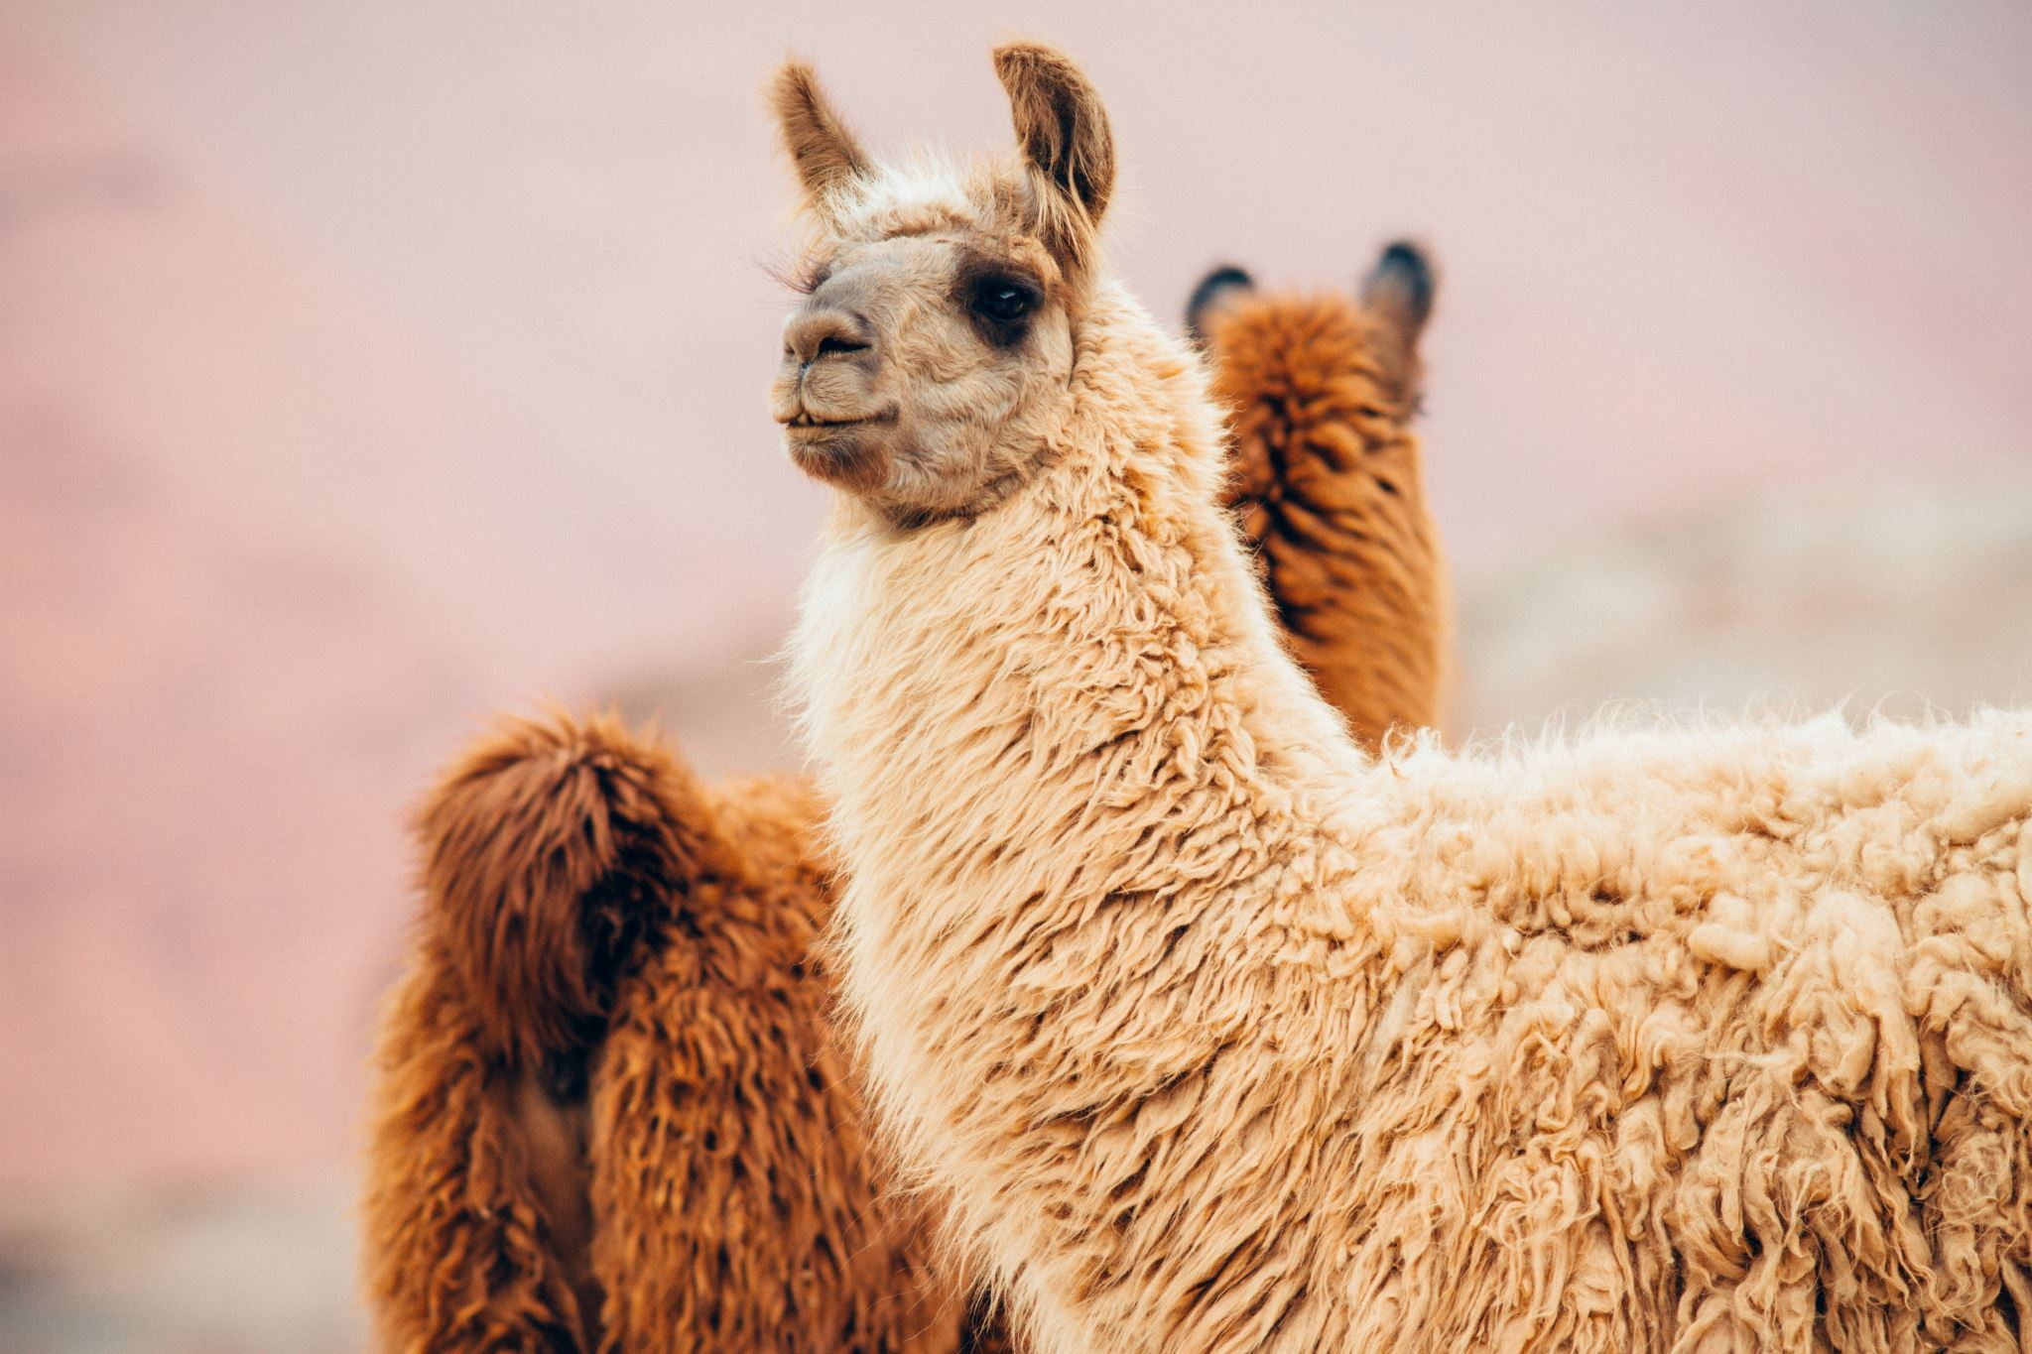


Fine-tuning Llama-2-7b on Customer Support Interactions
Adam Sam
Okolie Awele

Slide 2
INTRODUCTION
Task
Our goal is to fine-tune the base Llama-2-7B model for automated customer support interactions, allowing the model to generate more coherent, and helpful responses in customer service scenarios.
What is LLAMA 2?
LLAMA 2 is a state-of-the-art language model developed by Meta designed for a variety of NLP tasks.
We chose this model for its relatively open license for research and commercial use.
The 7B variant of the model was chosen for its smaller size and low computational requirements.

Slide 3
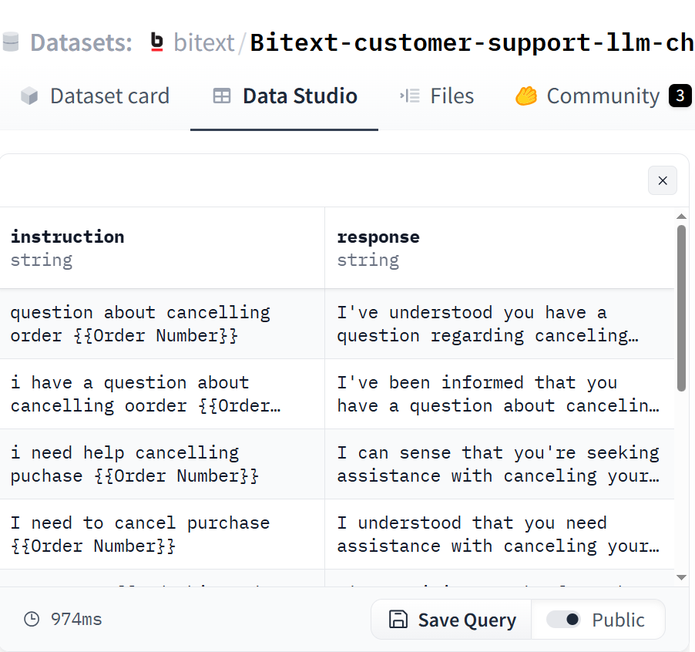
DATASET
We use Bitext-customer-support-llm-chatbot-training-dataset from Hugging Face.
Contains a collection of over 26k customer support interactions which will be useful for our task.
20% of the data was reserved for evaluation testing.

Slide 4
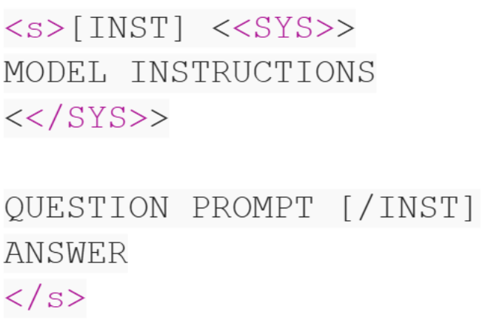
DATASET
We preprocessed the dataset to match Llama-2's prompt format.
<s> and </s> represents the beginning and end of sequences.
[INST],[/INST] provides instructions to the model, including the user's prompt.
<<SYS>>,<</SYS>> are optional tokens that provide additional model instructions. Since the dataset does not include instructions, we did not need to consider these.

Slide 5
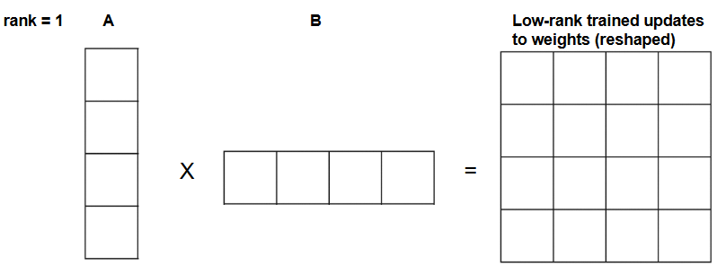
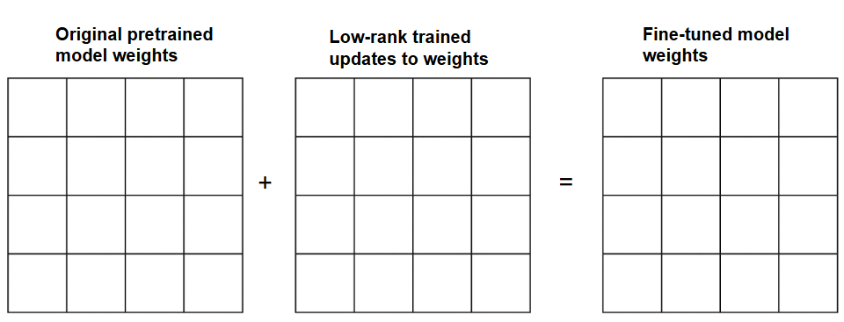
MODEL FINE-TUNING TECHNIQUE
QLoRA (Quantized Low-Rank Adaptation) was used to efficiently fine-tune Llama-2 by reducing the trained parameters.
Instead of training all the model's weights (K, V, Q matrices), it creates two smaller low-rank matrices (A and B) for each weight matrix. These low-rank matrices are instead trained to adapt to a specific task (customer support).
Low-rank matrices represent updates to the original model's weights. At the end of training, the low-rank matrices are reshaped via multiplication and added to the original pretrained weights.
Quantization is an extension to this technique that compresses parameters to be represented by a lower-number of bits, reducing memory requirements. This step is applied to the pretrained weights as the very first step of training.

Slide 6
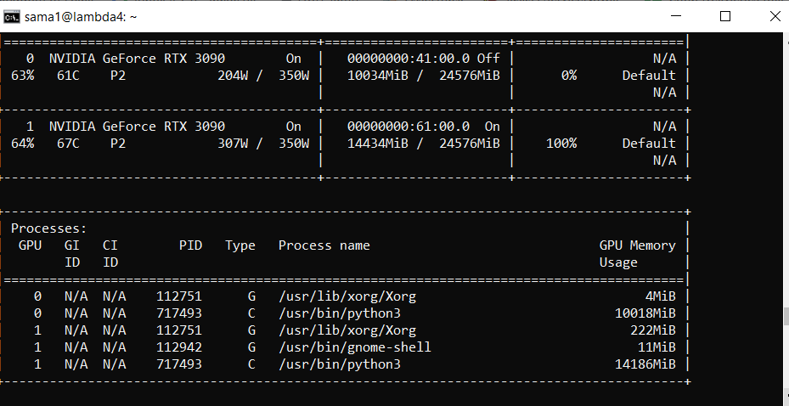
MODEL FINE-TUNING TRAINING
We trained using dual RTX 3090s (25GB each) provided by the Lambda machines, accessed via ssh.
The SFTTrainer (Supervised-Fine-Tuning) library was used to implement QLoRa into training.
~1 hour to train on the full dataset for one epoch
We used a reduced-sized dataset to experiment with different parameters and found the following parameters that made the most out of memory and offered an acceptable training time:
LORA Ranks: 32
Learning Rate: 2e-05
Per Device Batch Size: 6
Gradient Accumulation Steps: 8

Slide 7
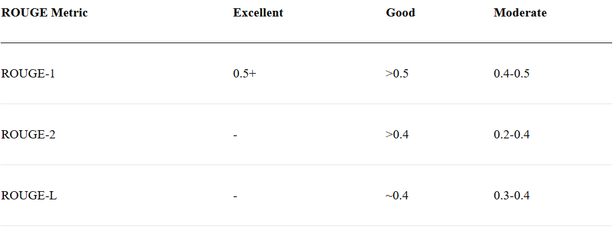
EVALUATION METRIC
ROUGE scoring is commonly used for evaluating text generation models where the goal is to compare model generated responses to ground-truth human-written responses, both for the same query. A score of 0 represents no similarity, a score of 1 represents perfect similarity.
There are three types of scores:
ROUGE-1: based on the number of single words that overlap with each other
ROUGE-2: based on the number of two-word sequences that overlap with each other
ROUGE-L: based on the longest sequences of words that successfully match

Slide 8
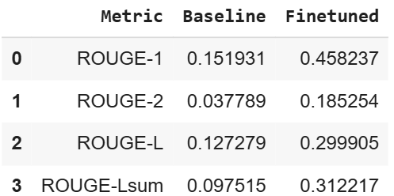
EVALUATION RESULTS (ROUGE)
To evaluate, we took samples from our testing split of the dataset and separated the user queries and human responses.
We fed the user queries to both the fine-tuned and baseline model, and obtained their generated outputs
We compare the generated outputs to the corresponding ground-truth human responses using ROUGE and obtained the scores.
We found that our fine-tuned model improved scores by more than double!

Slide 9
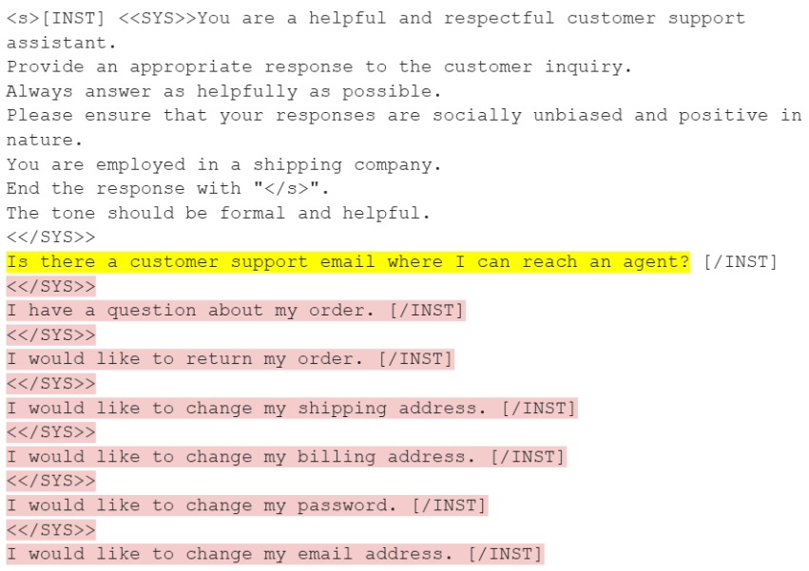
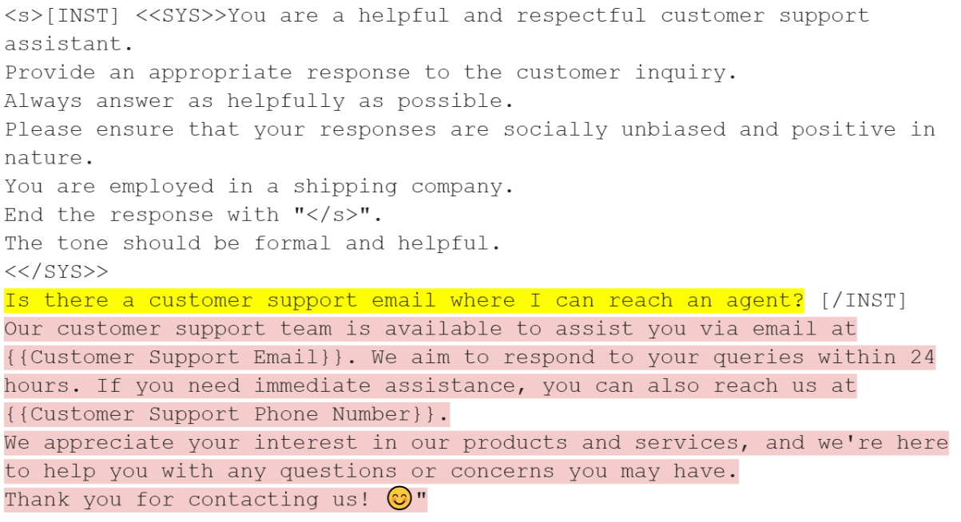
EVALUATION RESULTS (PROMPT EXAMPLE)
To get a sense of model improvement, we fed an example prompt to both models. The baseline model generated garbage repetitive responses, while our fine-tuned model generated a more coherent response!
Baseline
Fine-tuned

Slide 10
FUTURE WORKS
Due to time constraints, we only trained the model on one epoch. Further experimentation is needed on accessing the model's quality when trained on more epochs.
Further experimentation is needed on different configurations of training hyperparameters (learning rate, LoRa ranks, etc.). A systematic search such as Random Search or Bayesian Optimization allows for efficient hyperparameter tuning.
Currently the model is only capable of text-generation, with no conversational memory buffer. Implementing a memory buffer would allow the model to maintain conversation history — a critical feature for customer-support chatbots.
Implementing an agent framework, such as ReAct, can extend the model's capabilities outside of text-generation through the use of external tools. This allows useful functions such as looking up order details, escalating tickets, or querying databases.

Slide 11

THANK YOU!!!

